Slide 1
NoSQL

Slide 2
SQL vs NoSQL
Let's say you have a big collection of books in your library, and you want to keep track of information about each book, like the title, author, and genre.
In a traditional SQL database, you would create a table with columns for each of those pieces of information, and then insert a row for each book, filling in the details in the appropriate columns.
But with a NoSQL database, you could store all of the book information in one big document, like a giant card catalog. You wouldn't need to worry about making sure each book had the same fields filled out, or sorting them into tables, because you could just search the entire collection for the information you need.
So instead of having a bunch of tables with rows and columns, you have one big collection of documents with different kinds of information all mixed together. It might seem a bit chaotic at first, but it can be really useful for handling lots of data that doesn't fit neatly into a table format.

Slide 3
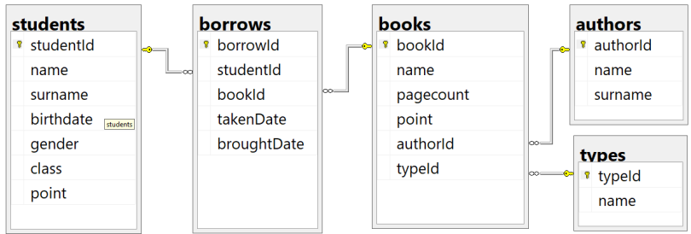
SQL

Slide 4
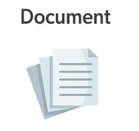
NoSQL

Slide 5
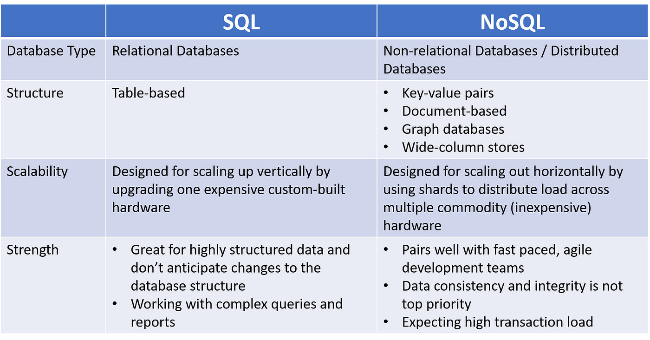
SQL vs NoSQL
When to use them?

Slide 6

Programming languages used
NoSQL databases use JSON (JavaScript Object Notation), XML, YAML, or binary schema, facilitating unstructured data.

Slide 7
Cosmos DB
It is Azure's inbuilt NoSQL server. Using the SQL API, you can query the data using SQL queries.
An API(Application Programming Interface) is like a helpful translator that lets different apps or programs talk to each other even if they speak different "languages." It's like a set of rules and tools that developers create so that their software can work together and share information.

Slide 8

NoSQL Software
Apache Cassandra, MongoDB, Redis, and Couchbase.

Slide 9
Lab 1

Slide 10
Storage account
The storage account for a set of data provides a unique namespace in Azure. The combination of the account name and the Azure Storage blob endpoint forms the base address for the objects in your storage account.
Notes:
If you're new to Azure Resource Manager, there are some terms you might not be familiar with.

Slide 11
Lab 2

Slide 12
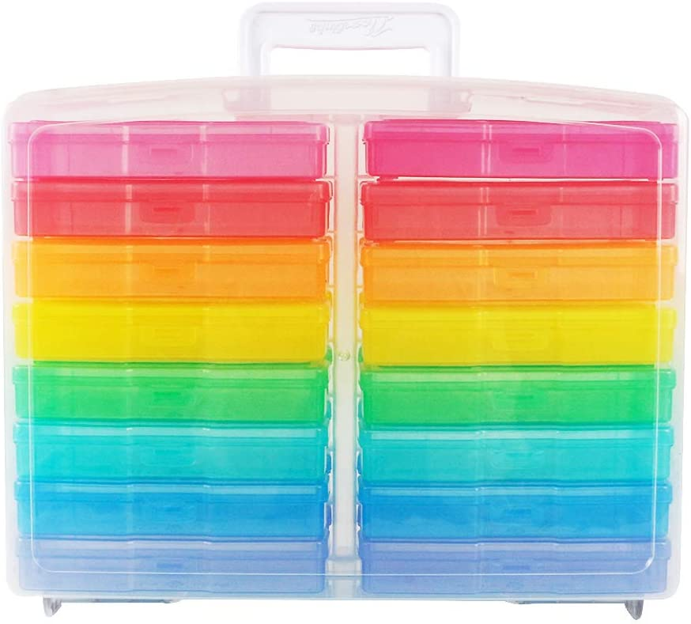
Azure Containers
A container organizes a set of blobs. A storage account can include an unlimited number of containers, and a container can store an unlimited number of blobs.
Think of the container as a big empty box with smaller boxes inside it. Much like the image alongside.

Slide 13
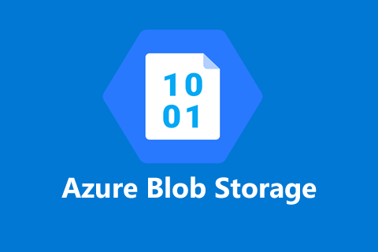
Azure Blobs:
Azure Blob is mainly used for serving images to a browser, storing files for distributed access, streaming video and audio, backup and restore and mainly for data storage and analysis by another Azure service.
Blobs within containers there are three types:
Block blobs store text and binary data, up to about 4.7 TB. Block blobs are made up of blocks of data that can be managed individually.
Append blobs are made up of blocks like block blobs, but are optimized for append operations. Append blobs are ideal for scenarios such as logging data from virtual machines.
Page blobs store random access files up to 8 TB in size. Page blobs store virtual hard drive (VHD) files and serve as disks for Azure virtual machines.

Slide 14
Lab 3

Slide 15

Azure Files
Key features of Azure Files
Azure Files makes it easy to move all your on-premises files and applications to the cloud and enables you to effectively manage your files in the cloud.
Azure Files makes it easy to "lift and shift" applications to the cloud that expect a file share to store file application or user data.
Azure Files offers multiple tiers that you can select based on your budget and performance needs.
Azure file shares can be used as persistent volumes for stateful containers. For the containers that access raw data at every start, a shared file system is required to allow these containers to access the file system no matter which instance they run on.

Slide 16
Lab 4

Slide 17
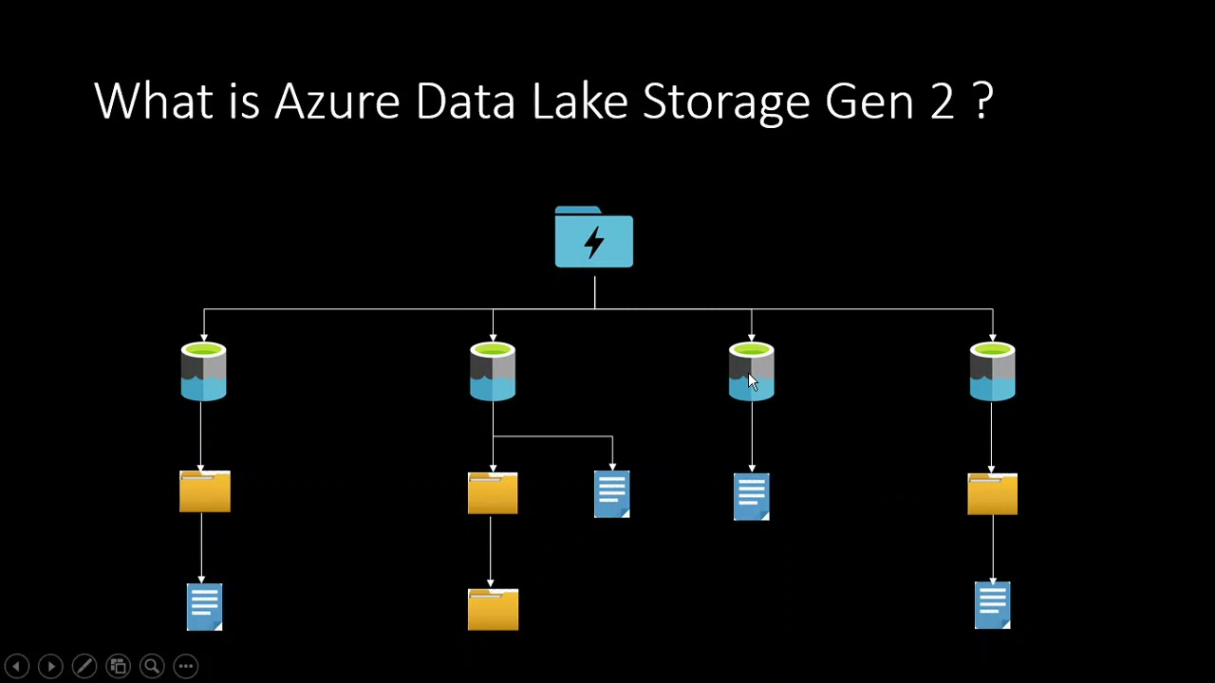
Azure Data Lake Gen 2
Microsoft Azure Data Lake is a highly scalable public cloud service that allows you to gain insight from large, complex data sets.
You can store an unlimited amount of structured, semi-structured or unstructured data from a variety of sources.
The service does not impose limits on account sizes, file sizes, or the amount of data that can be stored in a data lake.

Slide 18
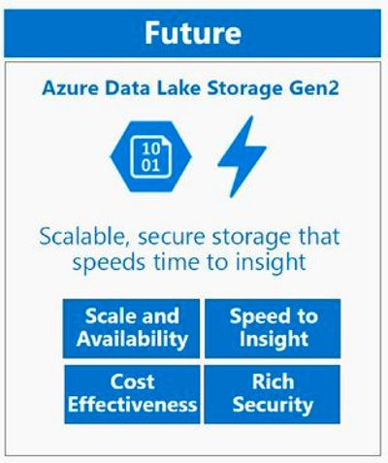
Azure Data Lake Gen 2 vs Blobs
Structure Blob: Flat namespace object store. ADLS: Hierarchical namespaces (much like a File System).
Purpose Blob: General purpose object store for a wide variety of storage scenarios, including big data analytics. ADLS: Optimized storage for big data analytics workloads.
Performance (Analytics Workload) Blob: Good storage retrieval performance. ADLS: Better storage retrieval performance.
Cost Blob: High cost for Analysis. ADLS: Low cost for Analysis.
Azure Data Lake Gen 2 = Azure Blob Storage + ADLS Gen1

Slide 19
Delete Resources

